Slide 1
Contract Testing – Using Pact
Presented by:
Pavan Kumar Nilagiri

Slide 2
Agenda
Contract Testing
How Does Contract Testing Works
Pact for Contract Testing
Pact Broker
Consumer Testing with Pact & Publish with Pact Broker
Provider Testing with Pact & Results
Demo

Slide 3
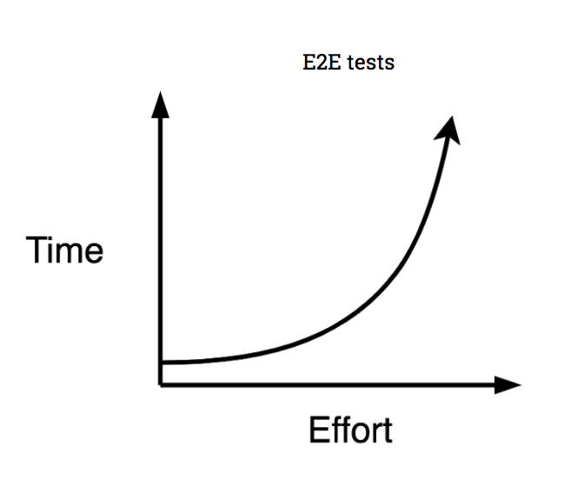
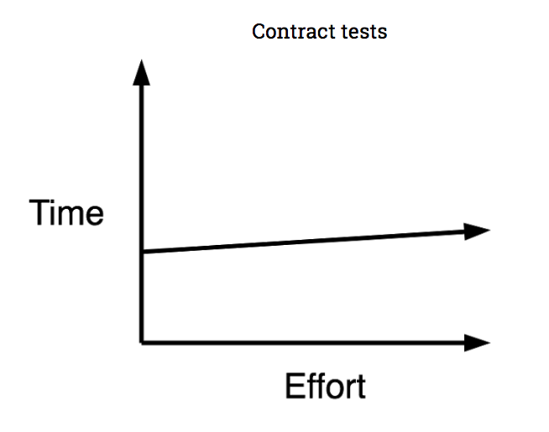
Contract Testing
Focus on contracts or agreements between different components
Detect issues early
Improve collaboration between teams

Slide 4
How Does Contract Testing Works
Create a set of rules or agreements between two services, known as a contract, and then testing that both services comply with these rules.

Slide 5
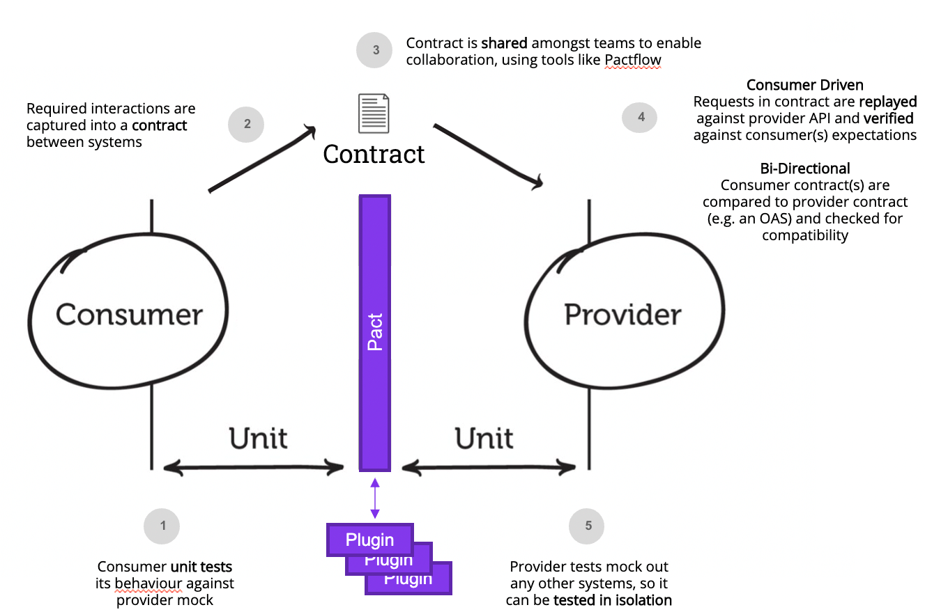
Pact for Contract Testing
Focus on consumer-driven contract testing, which allows teams to work more collaboratively and efficiently
Teams can catch issues earlier in the development process and avoid costly bugs in production
Pact generates tests automatically based on the contracts

Slide 6
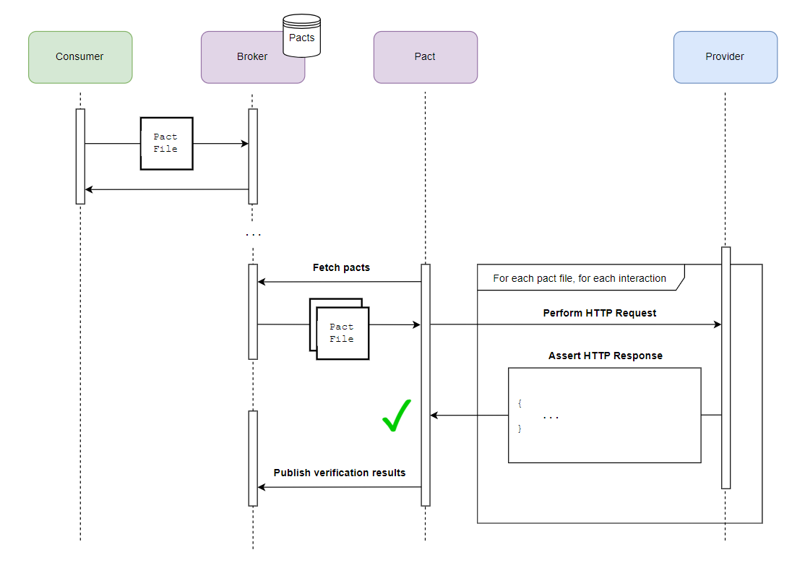
Pact Broker
Easily publish your contracts
Central repository for contracts
You can also set up webhooks to notify teams when a contract has been updated
Ways to share pacts
Local File System
Pact Broker
Amazon S3
CI Artifacts

Slide 7
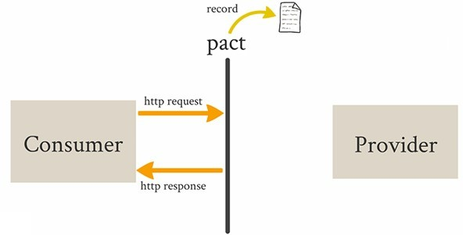
Consumer Testing with Pact
The consumer team (client) defines the expected interactions and behaviour of the API they are consuming.
These expectations are defined in the form of a Pact contract. A Pact contract specifies the request-response interactions, including request methods, paths, headers, query parameters, and expected responses.

Slide 8
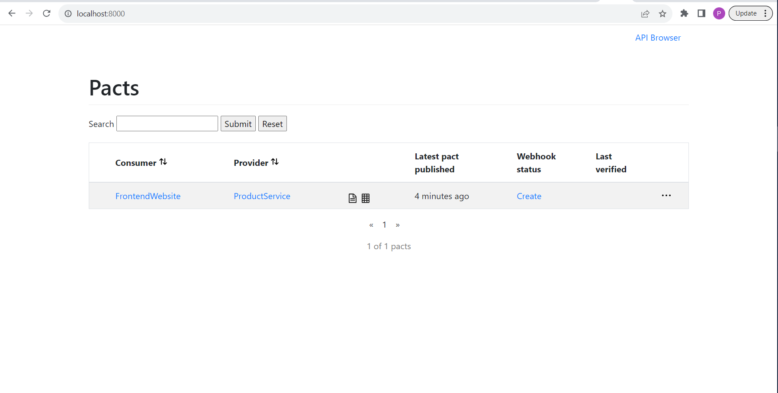
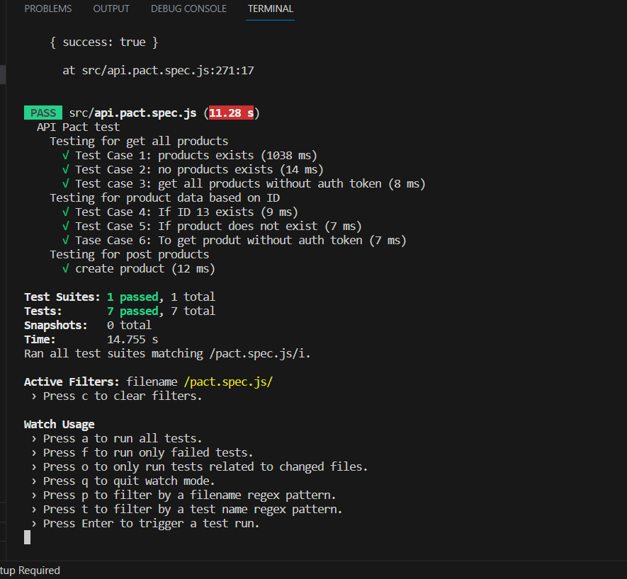
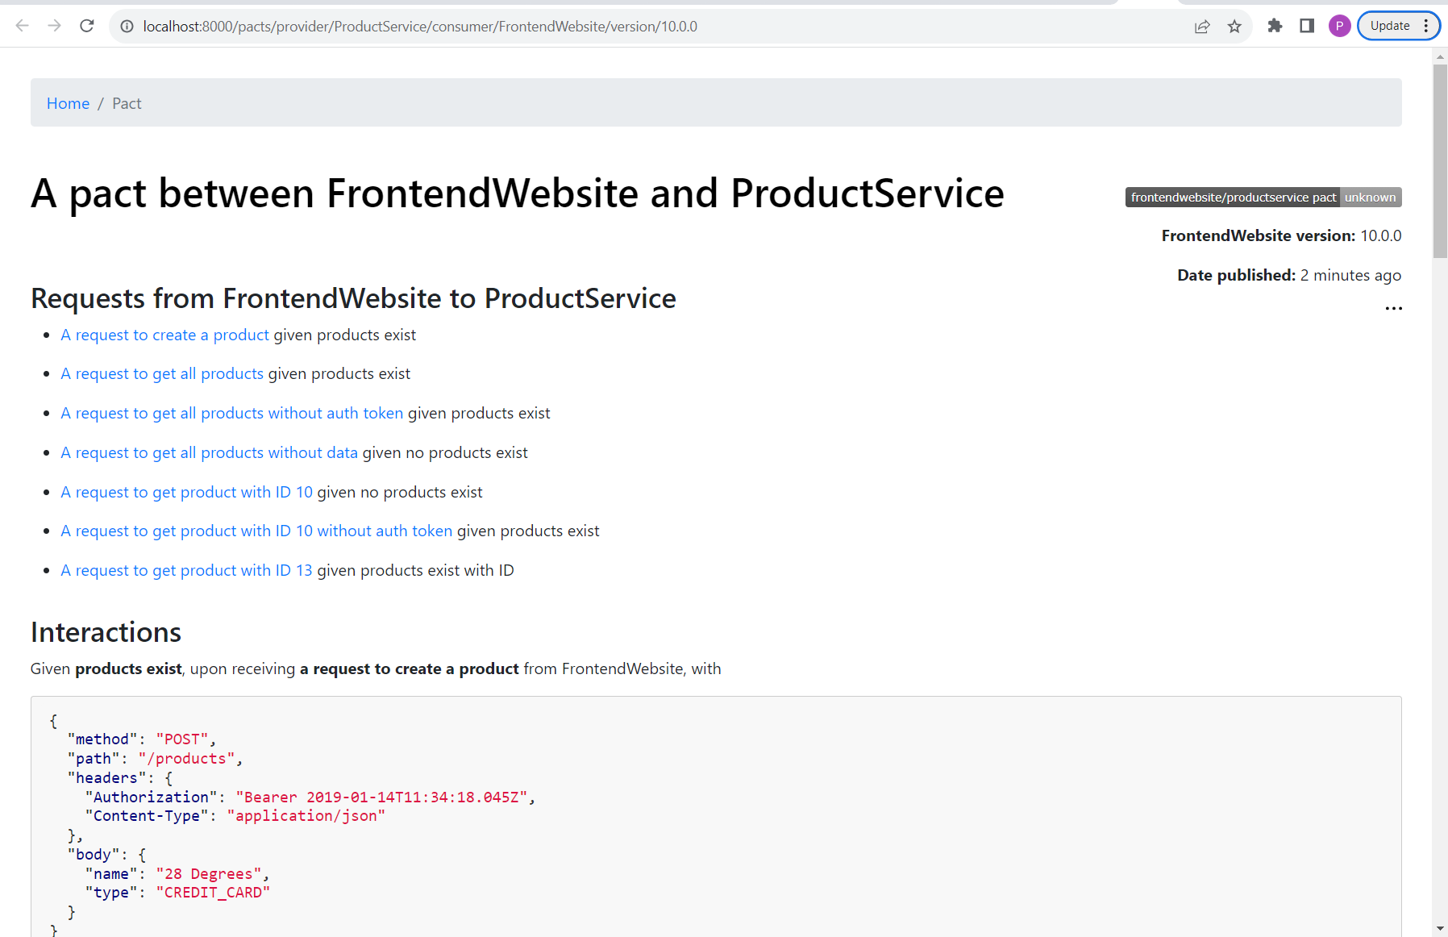
Pact Broker Results (After Consumer Test)
Pact Broker Home Page
Consumer Test Results
Pact File

Slide 9
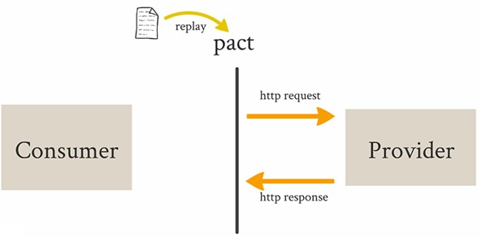
Provider Testing with Pact
Pact verification tests are automated tests on the provider side that compare the actual API responses to the expected responses specified in the Pact contract.
If the API implementation matches the expectations, the verification tests pass. If not, the tests fail, indicating a contract breach

Slide 10
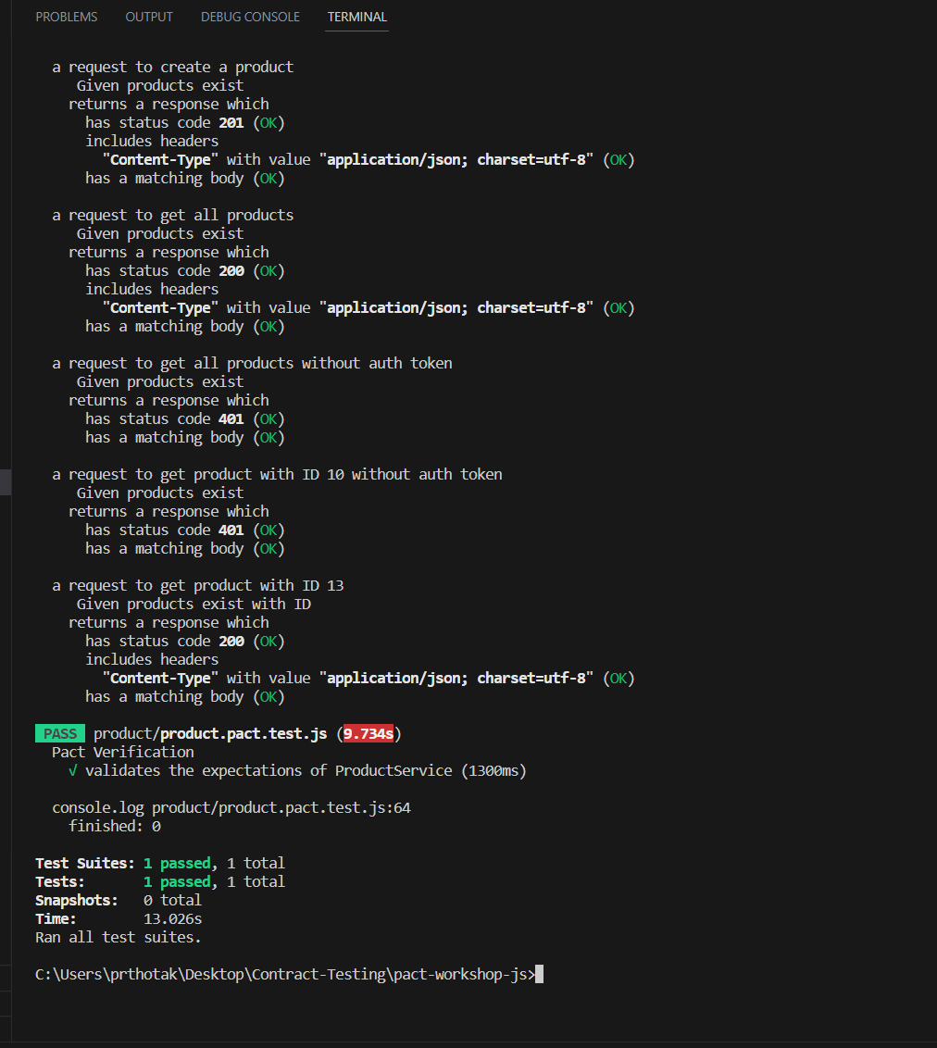
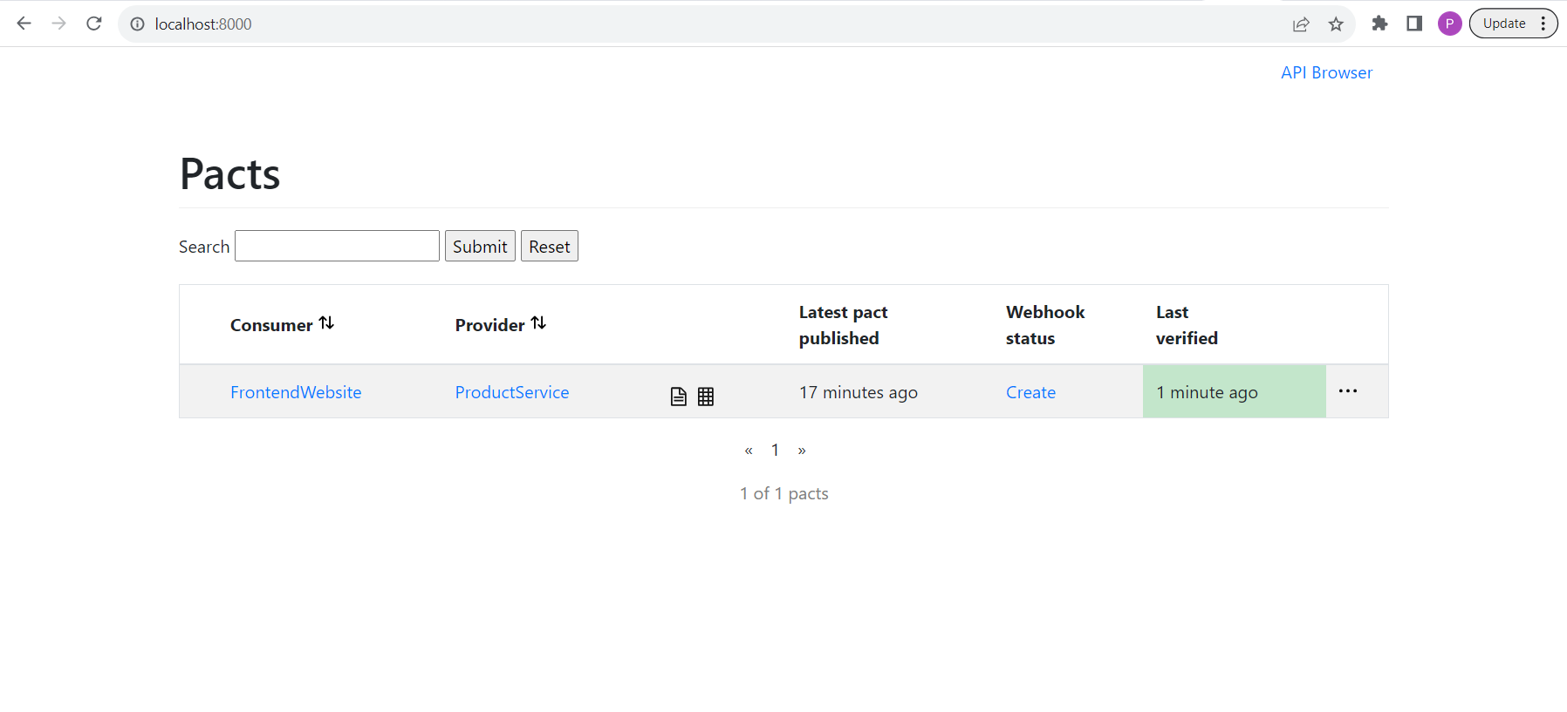
Pact Broker Results (After Provider Tests)
Pact Broker after Provider test
Provider test result

Slide 11
Demo

Slide 12

Thank You.!

